Slide 1
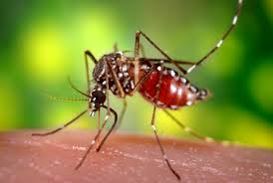
Yellow fever asuma

Slide 2
introduction
Yellow fever virus is an enveloped single stranded RNA virus of the family FLAVIVIRUS.
it has 3 genotypes;
I- CENTRAL Africa
IIA-west Africa
IIB- SOUTH AMERICA

Slide 3
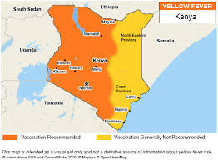
EPIDEMIOLOGY
Kenya is classified a low risk yellow fever infection country, with the last outbreak having occurred in 1992. (imported cases)
may be less severe in children, with subclinical infection–to–clinical case ratios of ≥2 : 1.
In areas where outbreaks of urban yellow fever are common, most cases involve children because many adults are immune.

Slide 4
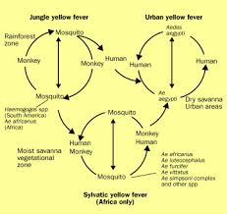
transmission
Yellow fever is transmitted through bite by an infected mosquito.
There are 2 transmission cycles.
Urban cycle. Human- aedes aegypti-human
Jungle cycle. Monkey- jungle mosquito-monkey.

Slide 5
pathogenesis
Direct viral injury to the liver interferes with fxns of liver including biosynthesis and detoxification.
Liver shows coagulative necrosis in midzone liver and eosinophilic degeneration of hepatocytes.
Micro vacuolar fatty change and minimal inflammation.
Heart- myocardial fibre degeneration and fatty infiltration

Slide 6
Patho.. cont
Kidneys- ATN
Brain- edema and petechial hemorrhages.
Hemorrhage is due to reduced synthesis of vit K dependent clotting factors

Slide 7
Clinical presentation
In Africa, clinically mild infxns are frequent.
Classic yellow fever- sudden onset of fever, headache, myalgia, lumbosacral pain, anorexia, nausea & vomiting.
After 2 days- brief remission followed by 6-24hr reappearance of symptoms including jaundice,deH2O, GI &other hemorrhages.
Death occurs within 7-10days. In severe cases the fatality rate approaches 50%.

Slide 8
Some patients survive the acute phase of illness but later succumb to renal failure or myocardial damage.
LAB FINDINGS.
LEUKOPENIA
Prolonged clotting, prothrombin& partial thromboplastin times(aptt)

Slide 9
Diagnosis.
High index of suspicion in endemic areas or hx of travel(non-immunized) to endemic area(2wks be4 onset).
Detection of virus or viral antigen in acute-phase blood samples.
Diff dx??

Slide 10
treatment
Keep pt in a mosquito free area- bc pts are viremic in acute phase.
Treatment largely supportive;
Sponging and acetaminophen to reduce temperatures
Vigorous fluid replacement

Slide 11
Treatment…cont
Correct acid-base imbalance
Maintain nutritional intake to lessen severity of hypoglycemia.
Avoid hepatotoxic, neurotoxic and nephrotoxic drugs.
Avoid drugs metabolized by liver.

Slide 12
complications
Severe hemorrhage
Liver failure
Renal failure

Slide 13
prevention
Yellow fever 17D live-attenuated vaccine.
Administered as a single dose of 0.5ml subcutaneous injection at least 10days before arrival in an endemic area.
Vaccination is valid for 10yrs for intl travel certification although immunity may last 40yrs- lifetime.

Slide 14
Contraindications
Infants less than 4months shldnt be vaccinated(risk of encephalitis and death)
Persons with symptomatic immune deficiency dzz
Pts on immunosuppressants
Ppl with hx of thymectomy.

Slide 15

Thank you for your attention have a fab day.

